Slide 1

Intent Recognition
Chatbot with
Sentimental Analysis
Project and Data Management Plan

Slide 2

Contents
1
Research Question?
2
Aims and Objectives?
3
Background?
4
Data & Data Ethics?
5
Project Plan?
6
Data Management Plan?

Slide 3

Research Question ?
Objective:
Design and implement an intelligent chatbot.
Core Functionalities:
User Intent Recognition:
Accurately determine what the user is asking or needs.
Appropriate Response Generation:
Provide relevant and context-aware answers or actions.
Enhancement Feature:
Sentiment Analysis:
Integrate sentiment analysis to understand the emotional tone of user inputs.
Enhance the chatbot's responses based on detected sentiment to improve user experience.
Overall Goal:
Create a chatbot that not only comprehends the user's intent but also adapts its responses based on the user's emotional state for a more engaging interaction.

Slide 4

Aim And Objectives
Project Aim:
Develop a machine learning model for intent recognition using the ATIS dataset to improve natural language understanding for airline travel queries.
Objectives:
Data Preprocessing:
Clean and prepare the ATIS dataset.
Algorithm Exploration:
Investigate and compare various classification algorithms.
Performance Evaluation:
Assess model performance using specific metrics.
Prototype Development:
Build a real-time interactive application for users.
Documentation:
Record methods and findings to clarify the process and reveal user behaviour patterns.
Privacy Assurance:
Ensure that privacy standards are maintained throughout the project.

Slide 5

Models Training
Start with Intent Recognition:
Begin Simple: Use traditional models (Logistic Regression/SVM) with TF-IDF or basic embeddings.
Increase Complexity: Explore deep learning models (LSTM, Bi-LSTM, CNN) and then transformer-based models (BERT).
Add Sentiment Analysis Next:
Baseline Approach: Begin with simple models (Logistic Regression/SVM) on a sentiment dataset.
Advance as Needed: Move to deep learning or transformer-based models for better performance.
Integration:
Combine both functionalities in a web-based interface, either by running separate models or using a multi-task learning approach.

Slide 6

Background
Chatbots in Airline Travel: Chatbots enhance interactions by understanding and responding to natural language queries in domains like airline travel.
Key Role of Intent Recognition: Accurate intent recognition is vital for managing complex travel queries, and machine learning models (e.g., RNNs, LSTMs, Random Forests) improve this process.
Research Foundations: The ATIS dataset underpins research in this area, guiding the development of chatbots that generate dynamic, context-aware responses for better user engagement.

Slide 7

Data and data ethics
Benchmark Dataset:
The ATIS dataset is a widely recognized benchmark for intent classification and slot filling in NLP, specifically for airline travel queries.
Annotated Queries:
It comprises around 5,000 user queries related to airline travel (e.g., flight information, reservations, cancellations) that are annotated with both intent labels and slot tags.
Accessible via NLTK:
The dataset is available through platforms like the Natural Language Toolkit (NLTK), facilitating its use in training models.

Slide 8
Data and data ethics
Diverse Intents and Slots:
It features a variety of intents such as booking flights, checking flight status, changing itineraries, and fare information, along with detailed slots like departure/arrival cities, dates, and times.
Real-World Relevance:
Its size and diversity make it an essential tool for developing robust conversational agents capable of managing realistic airline customer interactions.

Slide 9

data ethics
Dataset: No personally identifiable information (PII), so no anonymization required.
Usage: Focused on training ML models for intent classification and slot filling, adhering to research guidelines.
No New Participants: Only existing dataset used; no ethical approval needed.
Testing: Conducted via unit tests and cross-validation, ensuring controlled evaluation without external human involvement.

Slide 10
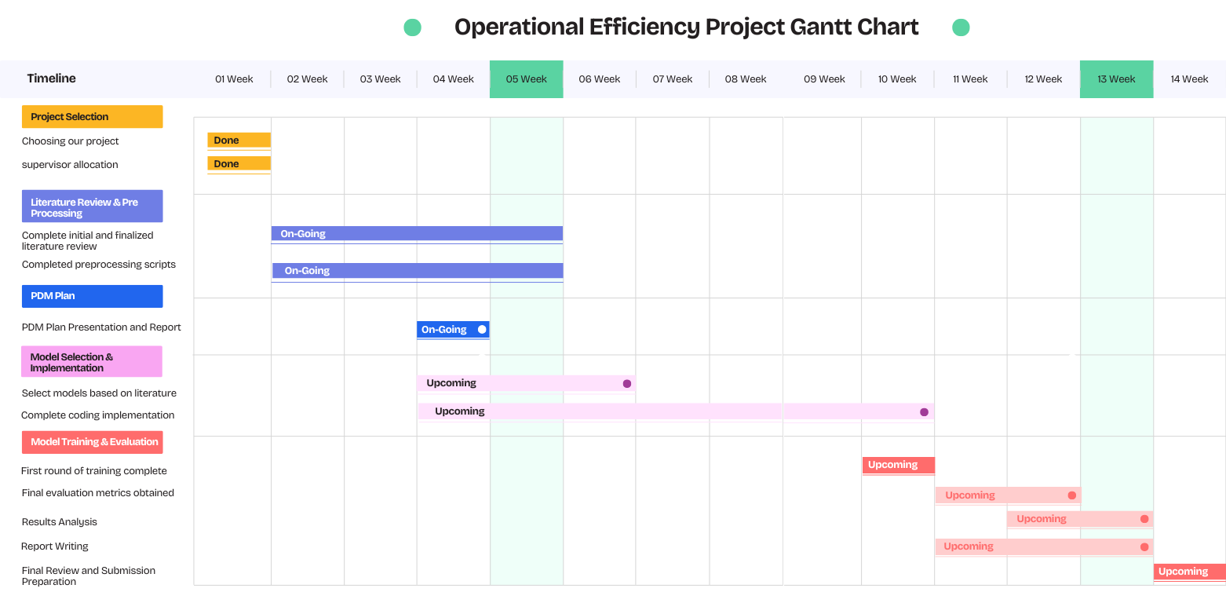
Project Plan

Slide 11
Data Management plan
Data Collection: Public datasets in CSV format.
Storage: Local and cloud (e.g., Google Drive).
Backups: Weekly (local) and bi-weekly (cloud).
Version Control: GitHub with weekly commits for code tracking.
My git rep link: https://github.com/Usama941/Chatbot.git
Goal: Organized management of data and code throughout the project lifecycle.

Slide 12

THANK YOU FOR LISTENING!

